Slide 1

with Mobile Web Specialist Certification
Broaden
Front-end
Tech-stack
Google Developers Certification
Du, Kai
2019.12.25

Slide 2
01
JavaScript
Evolution, Importance, Codelabs
02
Responsive CSS
Responsive, Codelabs
CONTENTS
03
Use Browser for debug
Tip for angular debug
04
What’s new?
PWA,Accessibilty
05
Exam Preview
Codelabs

Slide 3

JavaScript
/01
Evolution, Importance, Codelabs

Slide 4






JavaScript
Jquery
Angular/VUE/React
2008
2019
Jquery cover anything
Web Application
Most java developer also work as front-end developer
Front-end developer need to learn lot of framework and skill
……

Slide 5
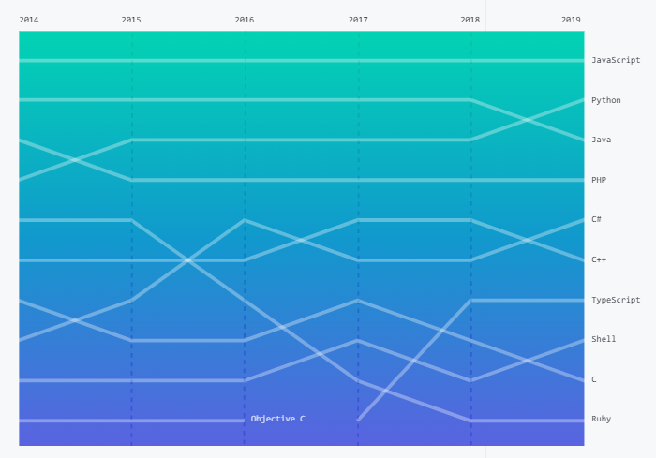
JavaScript
JavaScript has the most contributors in public and private repositories, organizations of all sizes, and every region of the world.
Most popular language on GitHub

Slide 6
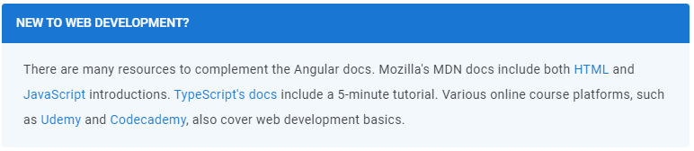

JavaScript
JavaScript is cornerstone of Angular development or any web application

Slide 7
//Replace with Odyssey FDM code
function postRequest() {
var myHeaders = new Headers();
myHeaders.append('Content-Type', 'application/json');
myHeaders.append( 'X-CUSTOM', 'hello world');
myHeaders.append( 'Y-Custom',"new");
fetch('http://localhost:5000/', {
method: 'POST',
headers: myHeaders,
body: JSON.stringify({ lab: 'fetch', status: 'fun' })
})
.then(validateResponse)
.then(readResponseAsText)
.then(showText)
.catch(logError);
}

Slide 8
//Replace Banana sample
function postRequest() {
var myHeaders = new Headers();
myHeaders.append('Content-Type', 'application/json');
myHeaders.append( 'X-CUSTOM', 'hello world');
myHeaders.append( 'Y-Custom',"new");
fetch('http://localhost:5000/', {
method: 'POST',
headers: myHeaders,
body: JSON.stringify({ lab: 'fetch', status: 'fun' })
})
.then(validateResponse)
.then(readResponseAsText)
.then(showText)
.catch(logError);
}

Slide 9
CSS
/02
Responsive, Codelabs

Slide 10
CSS
Users expect responsive and visually engaging websites regardless of the device. A web application's layout and styling must respond to the current display, while continuing to provide intuitive functionality.
Desktop
… …
Tablet
… …
Phone
… …

Slide 11
//Replace responsive CSS sample
@media screen and (max-width: 48rem) {
.container {
display: -webkit-box;
display: -ms-flexbox;
display: flex;
flex-flow: column;
}
}

Slide 12
Use Browser for Debug
/03
Tip for angular debug

Slide 13
Use Browser for Debug
Console.log/error/dir
Show .TS in chrome
1
3
……
……
Add breakpoint
Access component
2
4
……
……

Slide 14
PWA & Accessibility
/04
PWA and Accessibility quick start

Slide 15
//Replace service-worker sample
if ('serviceWorker' in navigator) {
window.addEventListener('load', () => {
navigator.serviceWorker.register('service-worker.js')
.then(registration => {
console.log('Service Worker is registered', registration);
})
.catch(err => {
console.error('Registration failed:', err);
});
});
}

Slide 16
//Replace with more sample
<input id="promo" type="checkbox"></input> <label for="promo">Receive promotional offers?</label>

Slide 17
Exam Preview
/05

Slide 18
//Demo in browser

Slide 19


Slide 20


